Slide 1
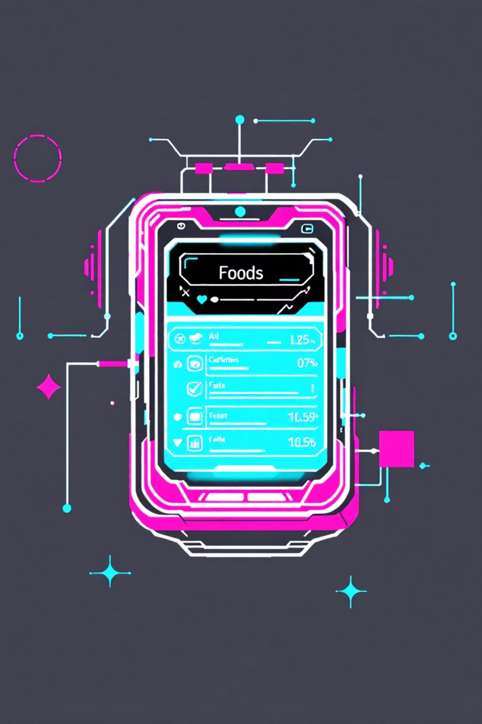
IngreSense-AI
Understand food ingredients instantly, without cognitive load.
AI-Native Consumer Health Experience

Slide 2

The Problem: Unclear Food Labels
Complex Ingredients
Long, chemical-heavy lists are hard to decipher.
Conflicting Guidance
Health advice is often unclear or contradictory.
Data Overload
Existing apps provide data, not actionable insight.
Time Pressure
Decisions are made quickly, leading to uncertainty.
Key insight: Food labels are optimized for regulation, not human understanding.

Slide 3

Why Existing Solutions Fail
Menu-driven, form-based interfaces
Require manual filters and configuration
Treat AI as an add-on feature
Dump raw data instead of reasoning
Result: Users remain uncertain at the exact moment decisions matter.

Slide 4

Our Vision: AI-Native Understanding
Reimagine ingredient understanding with an AI-native approach.
Intent-First
Focus on user intent, not manual filters.
AI Reasoning
AI reasons on behalf of the user.
Minimal UI
Maximum clarity with a simple interface.
Honest Communication
Transparently highlights uncertainty.

Slide 5


Proposed Solution: IngreSense-AI
An AI assistant that acts as a co-pilot, not a lookup tool.
Interprets Ingredients
Explains complex ingredients for the user.
Explains Significance
Clarifies why certain ingredients matter.
Highlights Trade-offs
Presents pros and cons, including uncertainty.
Reduces Cognitive Load
Simplifies decision-making at critical moments.

Slide 6





How It Works: User Flow
Scan Ingredient List
User scans or pastes image/text.
AI Infers Intent
AI automatically understands user's goal.
AI Reasons
AI processes and analyzes ingredients.
Insight Card Generated
One adaptive insight card is created.
Clarity in Seconds
User quickly reaches understanding.
No forms. No filters. No onboarding.

Slide 7

True AI-Native Experience
AI as Primary Interface
No Dashboards
AI is the core interaction, not a feature.
Focus on understanding, not data browsing.
Context-Aware
Silent Learning
Adaptive and relevant responses.
AI learns user preferences discreetly.

Slide 8

Reasoning & Explainability
The AI explains, rather than just listing ingredients.
Why it Matters
Trade-offs
Contextual explanation of ingredient impact.
Balanced view of benefits vs. drawbacks.
Uncertainty
Acknowledges scientific unknowns.
Uses clear, human-level language, avoiding jargon.

Slide 9

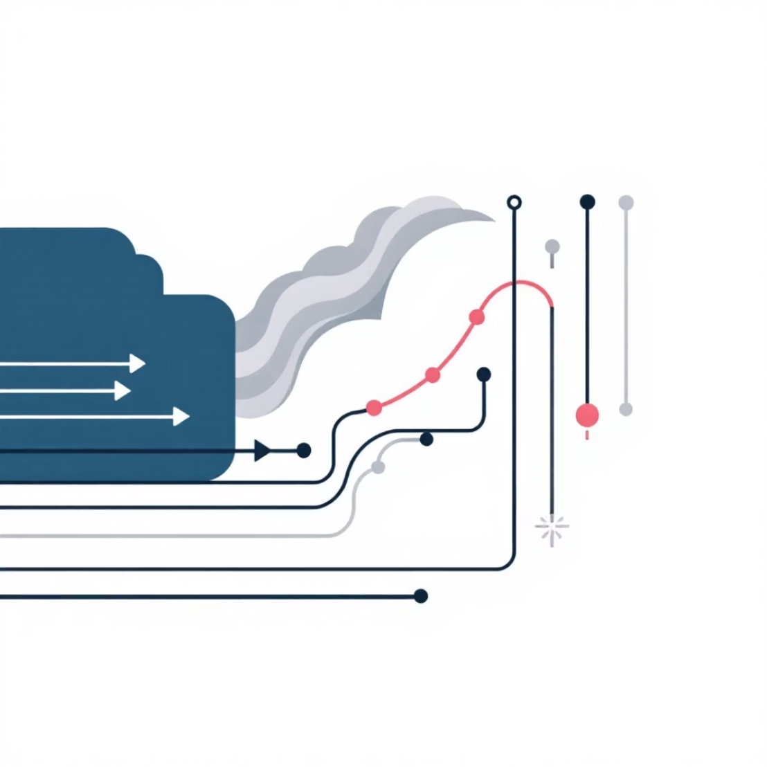
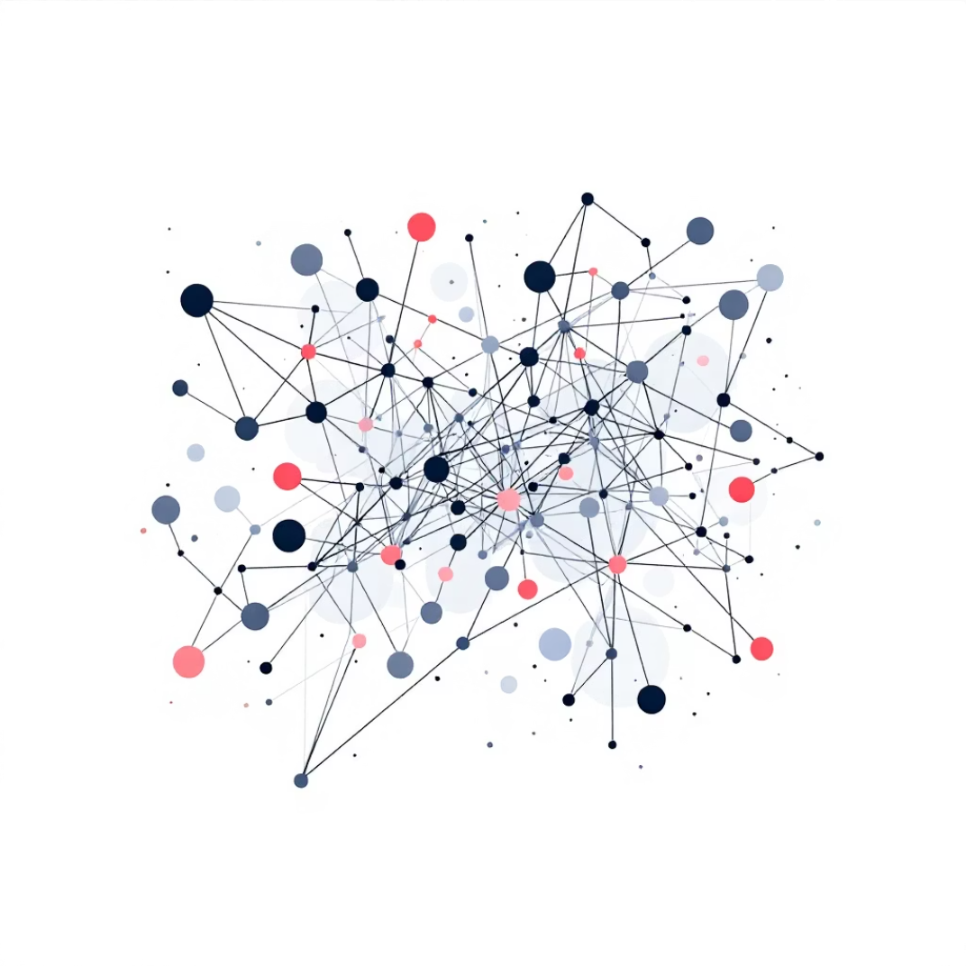
Technology Stack
Frontend
AI Layer
Data
Web application (React)
Large Language Model (LLM)
Simulated/partial data
Reasoning-driven prompts
OpenFoodFacts or mock datasets
Uncertainty-aware outputs
Design philosophy: Experience over data completeness.

Slide 10

Why Ingredient Co-Pilot Stands Out
True AI-Native Interaction
AI is the interface, not just a feature.
Minimal Cognitive Load
Simplifies complex information for users.
Transparent Uncertainty
Honest communication about unknowns.
Decision-Moment Design
Built for real-time, impactful choices.
Strong alignment with ENCODE judging criteria.

